Slide 1
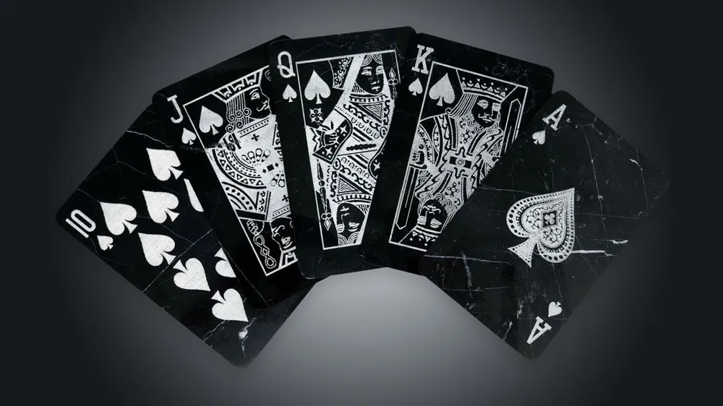


POKER GAME USING EXPECTIMINIMAX ALGORITHM
Team 一 07
Md. Rakibul Islam Rakib
191 1977 642
Md. Saifuzzaman Naim
191 2202 642
Shahriar Ahmad
201 2413 042
Md. Zubayer Ahmed
201 4073 642

Slide 2
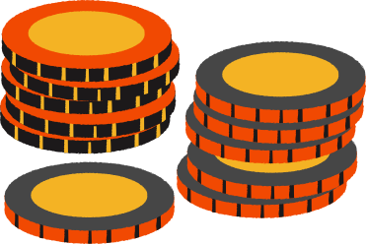
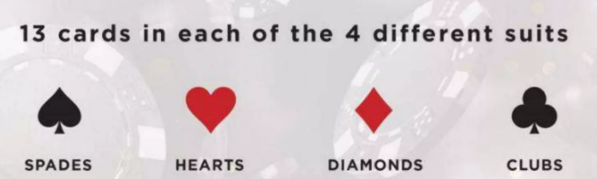
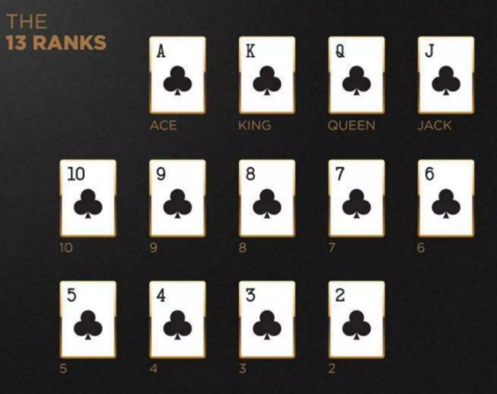
POKER GAME
What is it?
A card game played with a standard 52-card deck.
How to play?
Make the best five-card hand using :
2 private cards (dealt to each player)
5 community cards (shared and dealt).
Why Texas Hold’em?
Hold’em has evolved as the most popular poker game worldwide.
©️ Group 07 一 Md. Rakibul Islam Rakib | Md. Saifuzzaman Naim | Shahriar Ahmad | Md. Zubayer Ahmed.

Slide 3
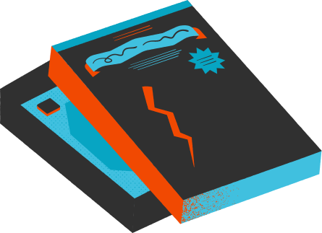
GOALS AND OBJECTIVES
01
To design the environment.
02
To develop poker game with Expectiminimax.
03
To evaluate the performance of the Expectiminimax algorithm efficiently.
04
Simulate the game with a UI.
©️ Group 07 一 Md. Rakibul Islam Rakib | Md. Saifuzzaman Naim | Shahriar Ahmad | Md. Zubayer Ahmed.

Slide 4

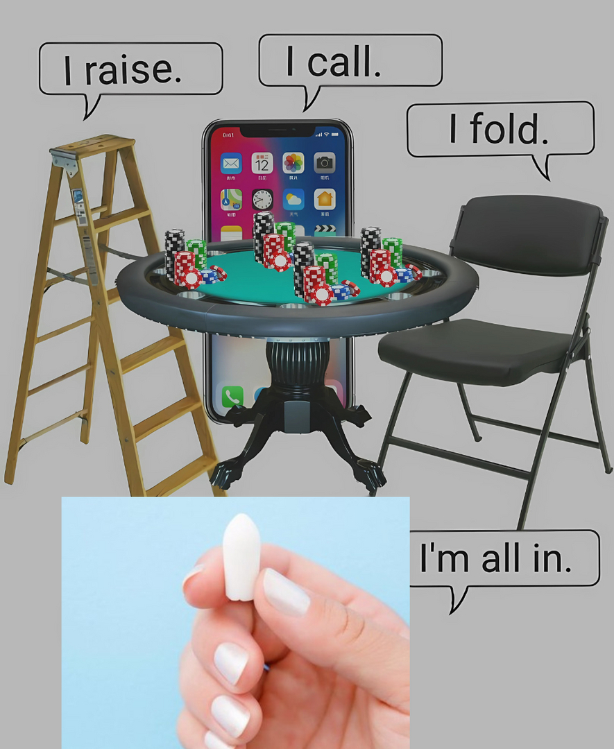




GAME ENVIRONMENT
(BASIC MOVES )
Raise
Call
Fold
Check
©️ Group 07 一 Md. Rakibul Islam Rakib | Md. Saifuzzaman Naim | Shahriar Ahmad | Md. Zubayer Ahmed.

Slide 5








GAME ENVIRONMENT
(BASIC MOVES 一 GAME PHASES AND COMPONENTS)
Phases :
Components :
Preflop
Cards
Flop
Deck
AI Players
Turn
River
Betting Rounds
©️ Group 07 一 Md. Rakibul Islam Rakib | Md. Saifuzzaman Naim | Shahriar Ahmad | Md. Zubayer Ahmed.

Slide 6




PROGRESS
Environment Setup
Basic Game Logic
Challenges Faced
Card, Deck, Player classes completed
All the game turns Implemented
Hand dealing & community cards implemented,
Simplified Dynamic AIs
Betting Logic & GUI
©️ Group 07 一 Md. Rakibul Islam Rakib | Md. Saifuzzaman Naim | Shahriar Ahmad | Md. Zubayer Ahmed.

Slide 7
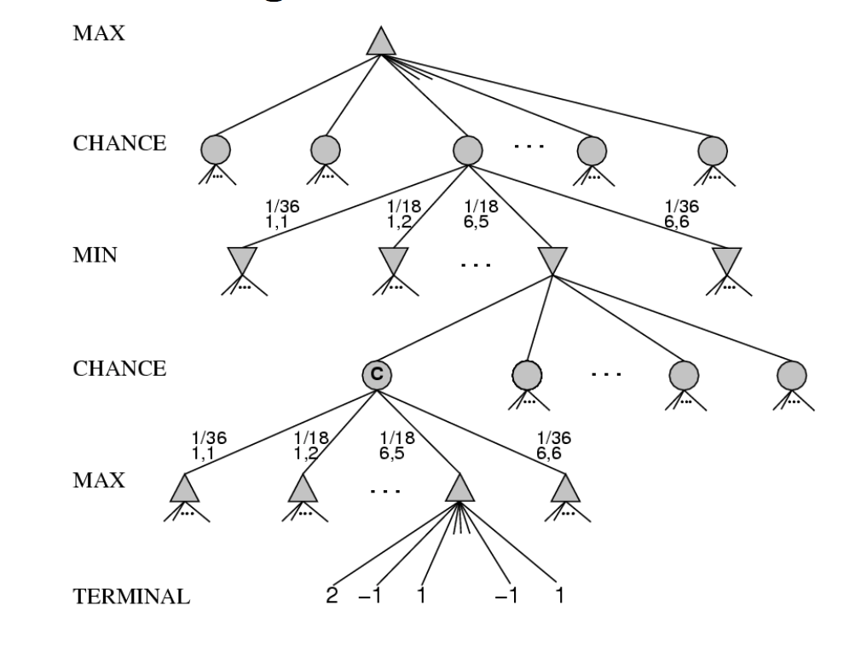
EXPECTIMINIMAX ALGORITHM OVERVIEW
01
02
03
AI evaluates possible hands & opponent actions
Uses probability-based decision-making
Incorporates randomness for uncertain outcomes
Implementation
01
02
03
Recursive search strategy
AI decision tree construction
Probability calculations for uncertain events
©️ Group 07 一 Md. Rakibul Islam Rakib | Md. Saifuzzaman Naim | Shahriar Ahmad | Md. Zubayer Ahmed.

Slide 8
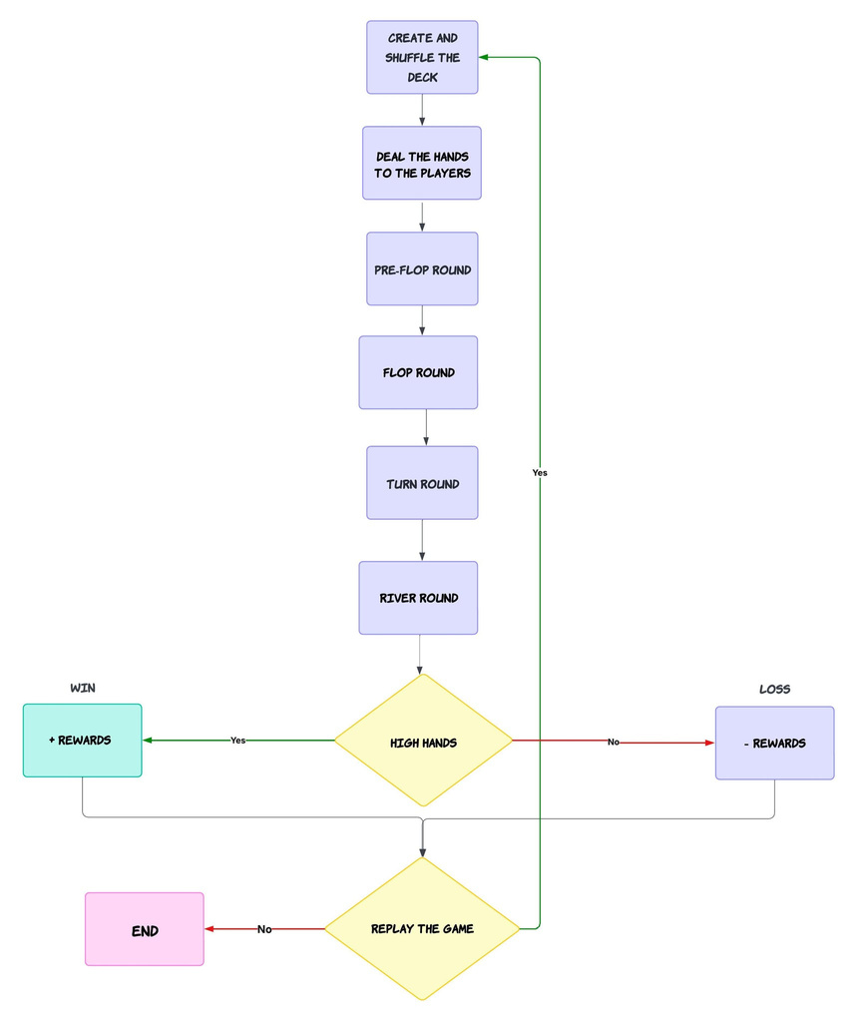
Methodology
Game Initialization: Start by creating and shuffling the deck.
Dealing: Cards are dealt to each player.
Gameplay Rounds: Progress through Pre-Flop, Flop, Turn, and River rounds.
Evaluation: Hands are evaluated at the end (High Hands).
Outcome:
Win: Rewards granted.
Loss: Penalties applied.
Replay Option: Players can choose to replay, looping back to deck creation.
Performance evaluation 一 through simulation trials, comparing the win rates of AI players using Expectiminimax against those using simpler strategies.
©️ Group 07 一 Md. Rakibul Islam Rakib | Md. Saifuzzaman Naim | Shahriar Ahmad | Md. Zubayer Ahmed.

Slide 9
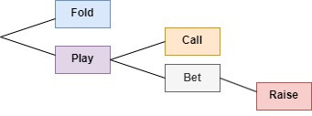
Methodology
Fold: Opt out of the hand if the odds or hand strength are unfavorable.
Play: Continue with the hand.
Call: Match the current bet to stay in the game.
Bet: Place a wager if no bet has been made.
Raise: Increase the bet to apply pressure or maximize value.
©️ Group 07 一 Md. Rakibul Islam Rakib | Md. Saifuzzaman Naim | Shahriar Ahmad | Md. Zubayer Ahmed.

Slide 10
Methodology
Expectminimax function is designed so AI can analyze decisions logically, helping users play more dynamically.
Breaks down complex poker actions into simple, step-by-step choices.
Mimics real-world scenarios to train AI on realistic decision paths.
Helps AI predict opponent behavior by mapping out possible moves.
Supports users in learning optimal responses through clear action pathways.
©️ Group 07 一 Md. Rakibul Islam Rakib | Md. Saifuzzaman Naim | Shahriar Ahmad | Md. Zubayer Ahmed.

Slide 11
LIMITATIONS
NEXT PLANS
No user Interface
Limited Input Validation
Basic AI Strategy
Static AI Opponent Count and Configuration
No Multiplayer or Online Capability
©️ Group 07 一 Md. Rakibul Islam Rakib | Md. Saifuzzaman Naim | Shahriar Ahmad | Md. Zubayer Ahmed.

Slide 12
FUTURE IMPROVEMENTS
NEXT PLANS
Expectiminimax Implementation Improvements
More dynamic Betting Logic
Hand Evaluation Optimization
Implementing User Interface
Chip Stack Management
©️ Group 07 一 Md. Rakibul Islam Rakib | Md. Saifuzzaman Naim | Shahriar Ahmad | Md. Zubayer Ahmed.

Slide 13
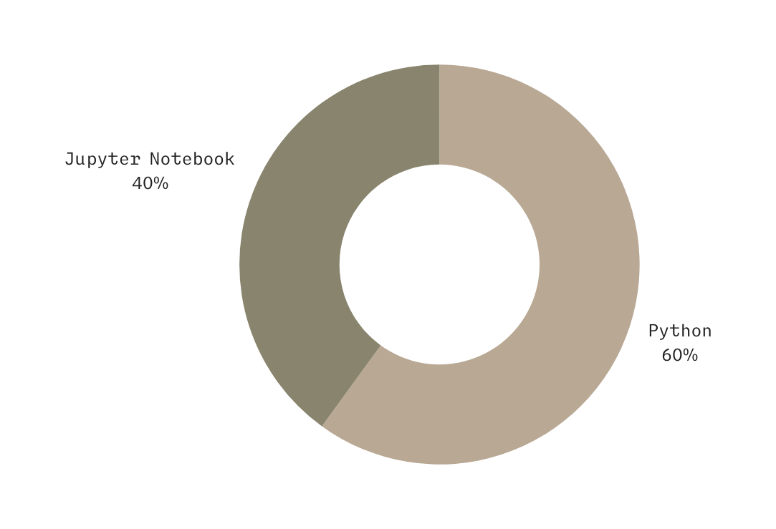
TOOLS
Language 一 Python
IDE 一 Jupyter Notebook
AI model 一 Expectiminimax
©️ Group 07 一 Md. Rakibul Islam Rakib | Md. Saifuzzaman Naim | Shahriar Ahmad | Md. Zubayer Ahmed.

Slide 14
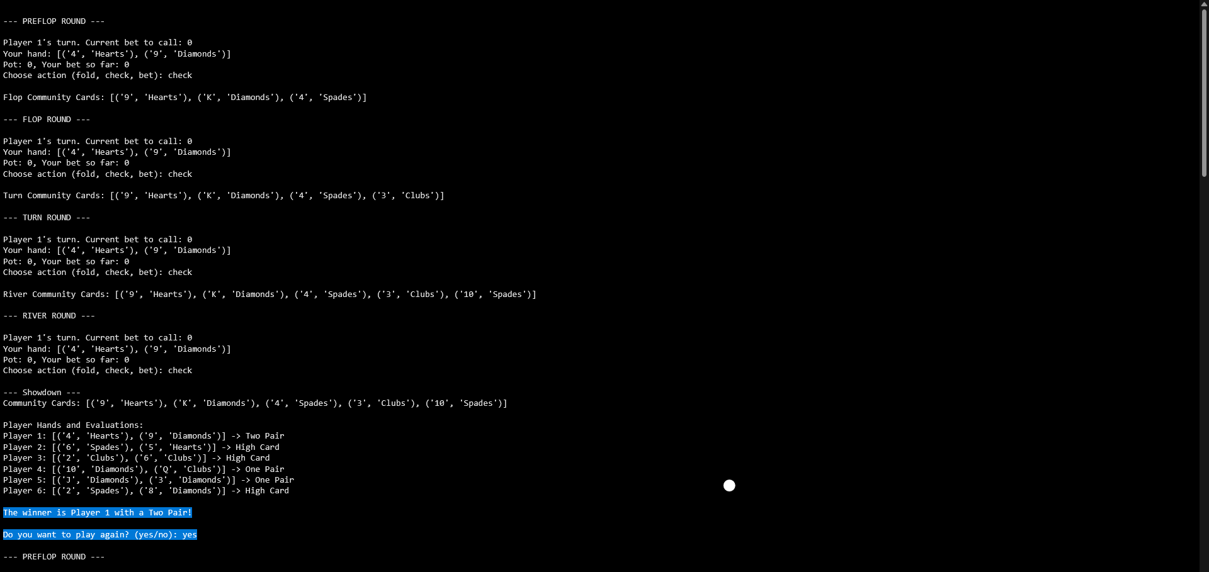



GAME-PLAY
01
AI plays optimally in uncertain scenarios
02
Comparison of Expectiminimax vs Simpler Strategies
03
Interactive poker simulation for research & learning
©️ Group 07 一 Md. Rakibul Islam Rakib | Md. Saifuzzaman Naim | Shahriar Ahmad | Md. Zubayer Ahmed.

Slide 15
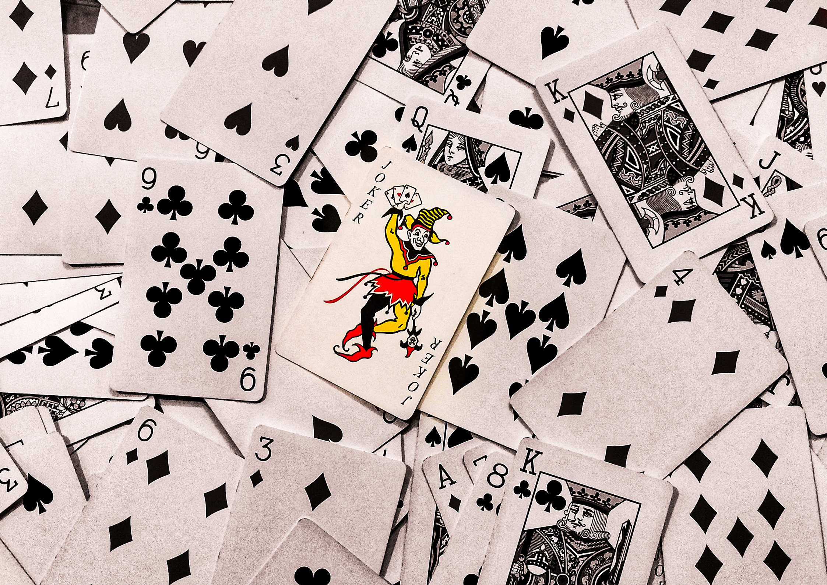
CONCLUSION
The project’s initial development is done. It’s designed for text-based interaction and allows the player to experience poker against AI opponents who make realistic decisions based on the current game state.
The foundational components are established, and future efforts will focus on improving the game logic, developing the Expectiminimax algorithm further as well as implementing a proper GUI interface.
©️ Group 07 一 Md. Rakibul Islam Rakib | Md. Saifuzzaman Naim | Shahriar Ahmad | Md. Zubayer Ahmed.

